Slide 1
Ensemble Methods in Machine Learning

Slide 3

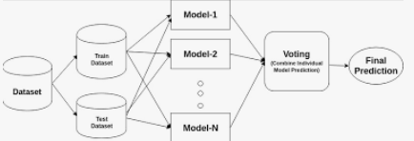
Ensemble methods are a set of techniques in machine learning that combine multiple models to improve predictive performance.
The core idea behind ensemble learning is that a group of weak learners can come together to form a strong learner, reducing variance, bias, and improving accuracy.

Slide 4
Why Use Ensemble Learning?
Improved Accuracy:
Combining multiple models reduces the chance of making an incorrect prediction.
Reduced Overfitting: Averaging multiple models prevents a single model from capturing noise in the training data.
Reduced Variance: Multiple models balance each other’s errors, leading to a more stable prediction.
Handles Complex Problems: It works well for non-linear and complex decision boundaries.

Slide 5
Types of Ensemble Methods
There are three main types of ensemble learning methods:
Bagging (Bootstrap Aggregating)
Boosting
Stacking (Stacked Generalization)

Slide 6
Bagging (Bootstrap Aggregating)
Bagging is an ensemble technique that trains multiple models (usually of the same type) independently using different subsets of the training data obtained through bootstrapping (random sampling with replacement).
The final prediction is made by aggregating the outputs of all models, typically using majority voting (for classification) or averaging (for regression).
Working of Bagging:
Draw multiple bootstrap samples from the original dataset.
Train a model (e.g., Decision Tree, SVM) on each sample independently.
Aggregate predictions (majority vote for classification, mean for regression).

Slide 7
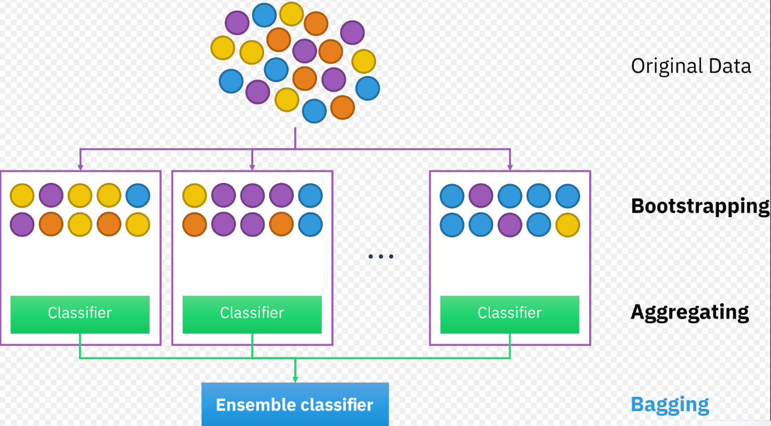

Slide 8
Random Forest: Uses bagging with decision trees, adding feature randomness to reduce correlation between trees.
Advantages of Bagging
✔ Reduces variance (good for overfitting models like Decision Trees). ✔ Works well for high-dimensional data. ✔ Stable and easy to implement.
Disadvantages of Bagging
✖ Doesn't reduce bias (not useful for underfitting models like Linear Regression). ✖ Computationally expensive for large datasets.

Slide 9
Random Forest

Slide 10
Random Forest
Random Forest is a popular machine learning algorithm that belongs to the supervised learning technique.
It can be used for both Classification and Regression problems in ML. It is based on the concept of ensemble learning, which is a process of combining multiple classifiers to solve a complex problem and to improve the performance of the model.
The greater number of trees in the forest leads to higher accuracy and prevents the problem of overfitting.
It predicts output with high accuracy, even for the large dataset it runs efficiently.
It is capable of handling large datasets with high dimensionality.
It enhances the accuracy of the model and prevents the overfitting issue.

Slide 11
🔍 Step-by-Step Working of Random Forest Classifier:
1. Bootstrap Sampling (Bagging):
From the original training dataset, multiple new datasets (called bootstrap samples) are created by sampling with replacement.
Each of these datasets is used to train one decision tree.
2. Building Decision Trees with Random Features:
For each node split in a decision tree, only a random subset of features is considered, not all features.
This introduces feature randomness and helps create diverse trees.
3. Growing Each Tree:
Each tree is grown fully (can be pruned later optionally) using its bootstrap sample.
Splitting at each node is done using criteria like Gini Index or Entropy (information gain).

Slide 12
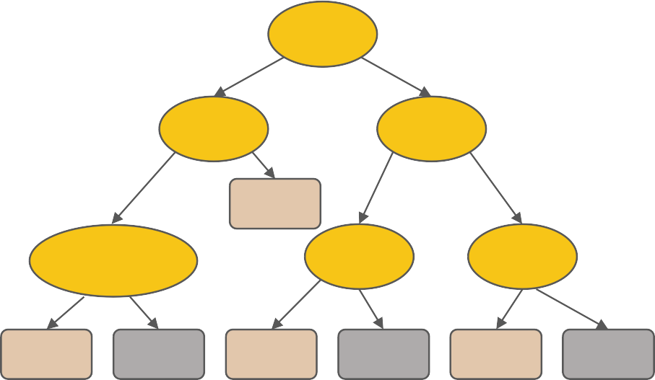
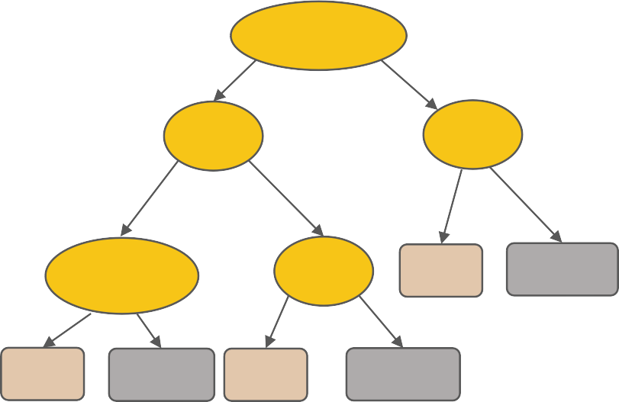

Random Forest Classifier
Location Similarity
Gene Expression
Domain-motif
Interact
M features
Neighbor Function Similarity
Degree
Gene Expression
Interact
Not Interact
Interact
Not Interact
Interact ^{Not Interact}
N examples
Neighbor process similarity
Take the majority vote
Tissue Expression
Centraility
....…
Neighbor Function Similarity
PTM
Interact
Not Interact
Interact
Not Interact
Interact
Not Interact
Neighbor process similarity
Tissue Expression
Centraility
Neighbor Function Similarity
PTM
Interact
Not Interact
Interact
Not Interact
Interact
Not Interact

Slide 13
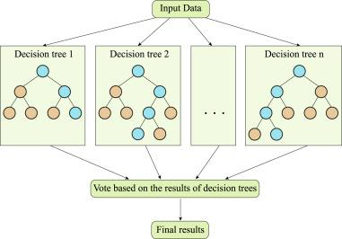
Random Forest Classifier
Random forest is based on decision trees and implemented with three steps,
(i) sub-sampling,
(ii) decision tree training,
(iii) prediction

Slide 14
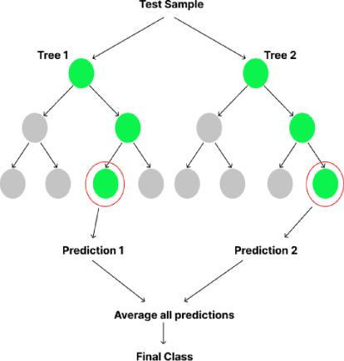
Random Forest Regressor
Random Forest (RF) is based on the concept of ensemble learning, the process of combining multiple classifiers to solve a complex problem and improve the performance of the model.
It is a regressor that contains a set of decision trees in various subsets of the given data set and takes the average all the predictions to find the predictive accuracy.

Slide 15
✅ Advantages:
Reduces overfitting compared to a single decision tree.
Handles large datasets and high-dimensional spaces well.
Can handle missing values and imbalanced data better than many algorithms.
⚙️ Hyperparameters (important ones):
N_estimators: Number of trees in the forest.
Max_features: Number of features to consider when looking for the best split.
Max_depth: Maximum depth of each tree.
bootstrap: Whether bootstrap samples are used.
criterion: Function to measure the quality of a split (Gini, entropy).

Slide 16
Thanking you

